Slide 1

DATA ANALYTICS INTERNSHIP 2024 Final Project Presentation
Project: Analyzing renewable energy production across different nations and their effects on carbon emissions
Team : LazyBuds
College : Maharaja Agrasen Institute of Technology
IBM SKillsBuild Data Analytics

Slide 2

TEAM MEMBERS
RACHIT MITTAL
ARJUN YADAV
SHIVAM BAJPAI

Slide 3
TEAM MEMBERS
GAURAV DHARIWAN
VIPIN SINGH
HARSH VARDHAN

Slide 4
INTRODUCTION
This project explores the impact of renewable energy generation on carbon emissions reduction and examines the variation in renewable energy production across different countries.
By analyzing data on renewable energy sources like solar, wind, and hydro, and their respective contributions to decreasing greenhouse gas emissions, this study aims to highlight the global disparities and progress in transitioning to sustainable energy systems.
The findings will provide insights into how different nations are addressing climate change through renewable energy and the challenges they face in achieving their energy goals.

Slide 5

PROBLEM STATEMENT
analyze how renewable energy generation has contributed to carbon emissions reduction and to investigate the disparities in renewable energy production worldwide.
RATIONALE
The rationale for this project lies in the urgent need to address climate change by reducing carbon emissions through the adoption of renewable energy sources. Renewable energy, such as solar, wind, and hydro, offers a sustainable alternative to fossil fuels, yet its adoption varies significantly across different countries

Slide 6
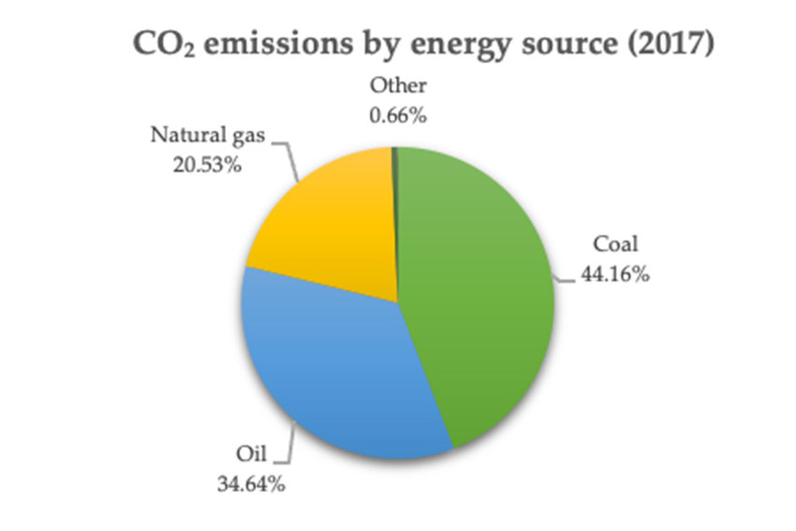
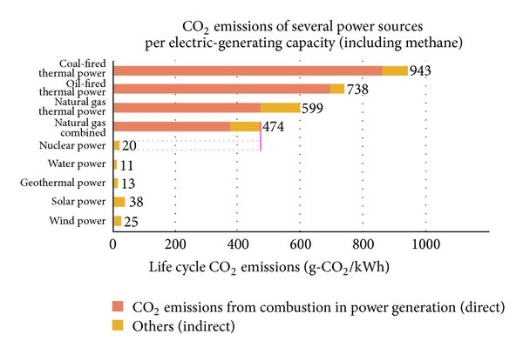
SIGNIFICANCE
By analyzing the impact of renewable energy generation on carbon emissions reduction and examining the disparities in production, this project seeks to identify best practices and challenges. Understanding these variations is essential for informing policy decisions, fostering international cooperation, and accelerating the global transition to renewable energy, ultimately contributing to a more sustainable and resilient future.
As a result, thoroughly analyzing the data of different regions helps us to predict with accuracy the carbon footprint of each nation, and consequently their individual responsibility.

Slide 7






Relevant Sustainable Development Goals (SDGs)
SDG 7: Affordable and Clean Energy
SDG 13: Climate Action
SDG 9: Industry, Innovation, and Infrastructure
SDG 12: Responsible Consumption and Production
SDG 17: Partnerships for the Goals

Slide 8
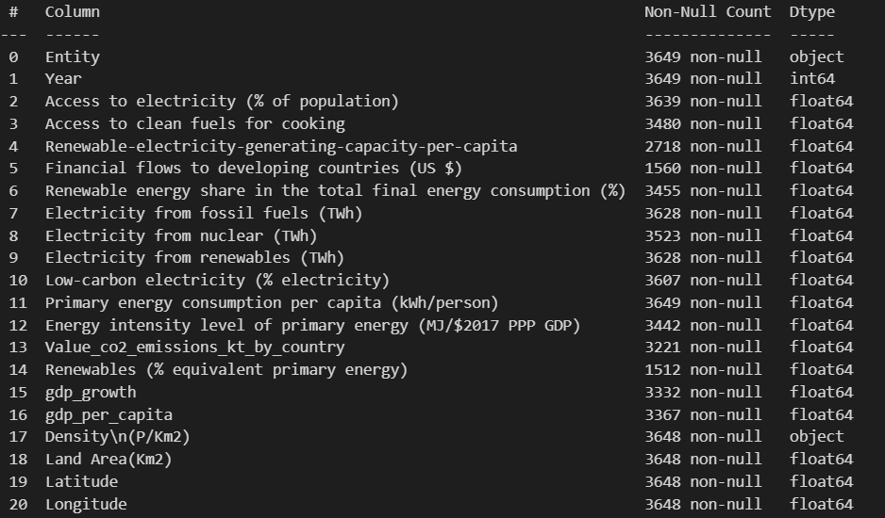
DATA COLLECTION
Data Source: Taken from Kaggle. Several features present which enable us to study in-depth about the relationship between energy production
and carbon emissions.

Slide 9
REFERENCES
DataSet Used : Global Data on Sustainable Energy
TOOLS & SOFTWARE Used :
Programming Languages: Python
Libraries: pandas & numpy for data manipulation matplotlib & seaborn for data visualization
IDE : Visual Studio Code

Slide 10
THANK YOU!

